Slide 1
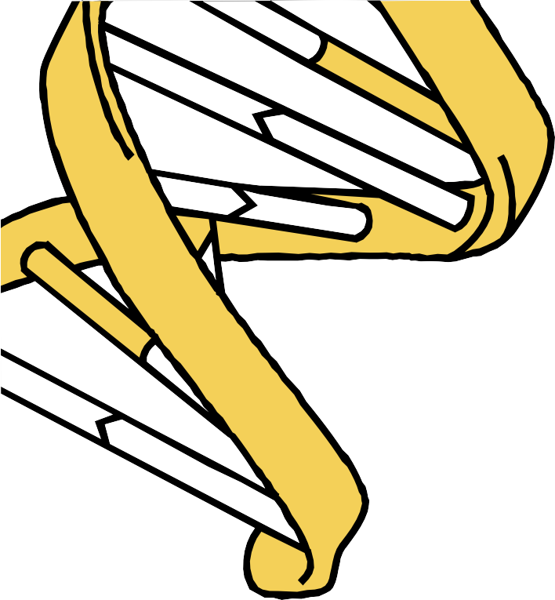

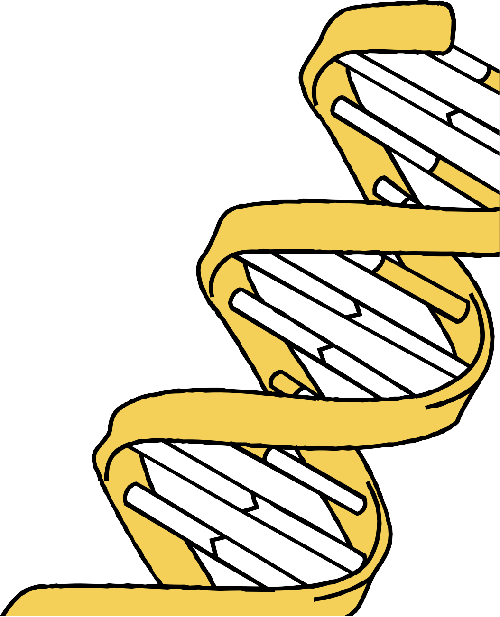
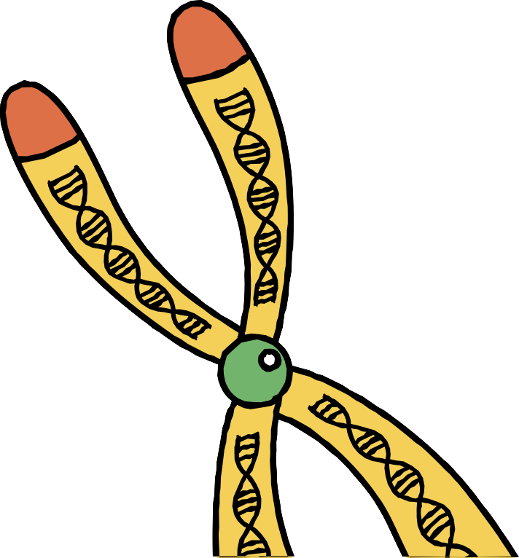
GENETIC ENGINEERING AND BIOTECHNOLGY
NAME: T.SANJAY
ROLL NO: 22R01A05C4

Slide 2
GENTIC ENGINEERING
Genetic engineering is the process of changing an organism's DNA to create new traits or characteristics

Slide 3
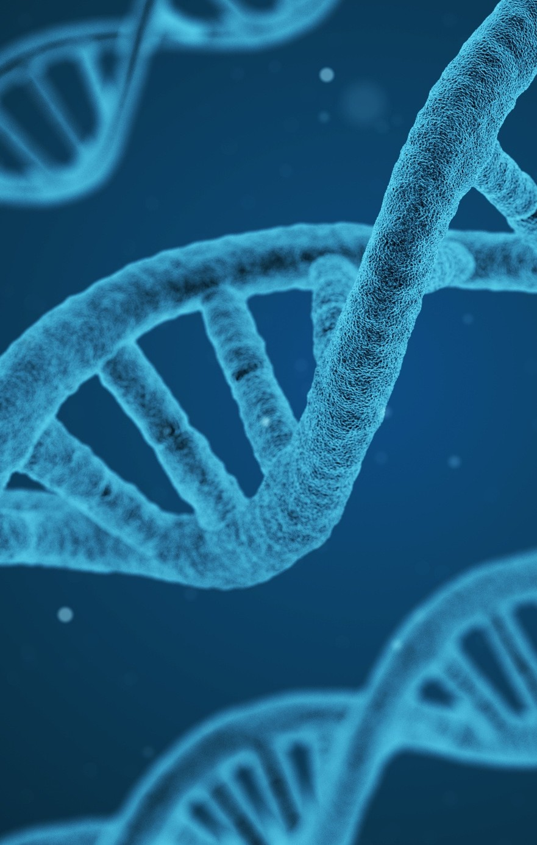
DNA
CHARACTERISTICS OF DNA
Deoxyribonucleic acid
Made of nucleotide monomers
DNA Double Helix
Consists of two nucleotide chains Each nucleotide consists of a sugar molecule, a phosphate group, and a nitrogen-containing base

Slide 4
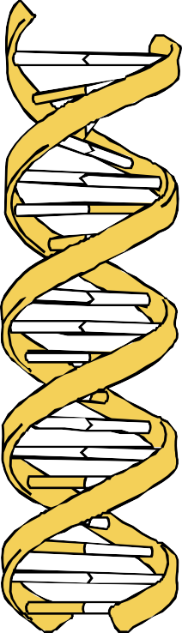
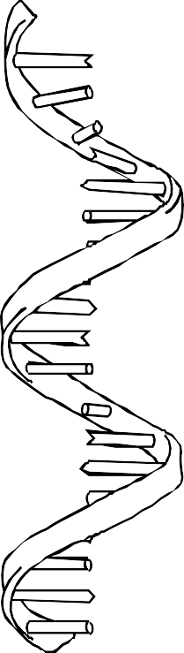
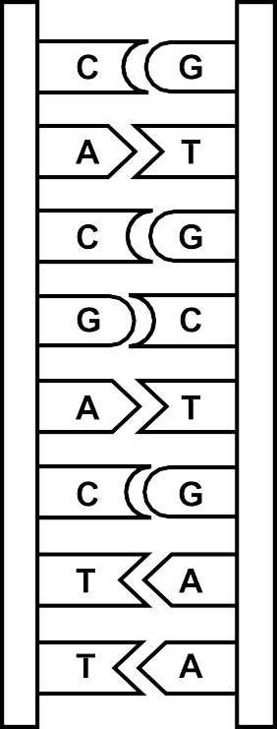
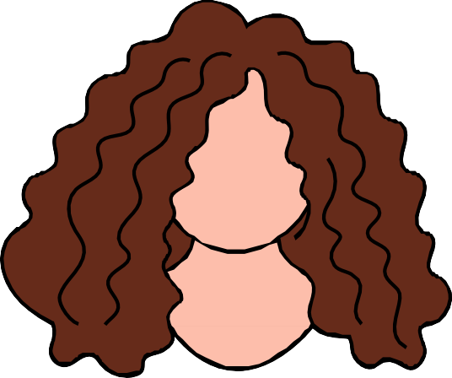
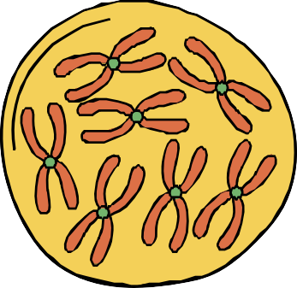
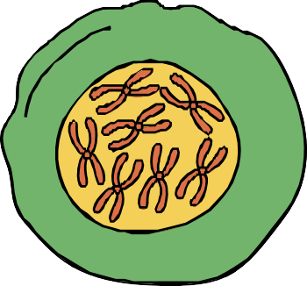

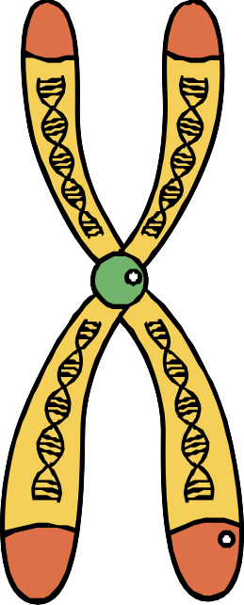





DNA Differences

Slide 5
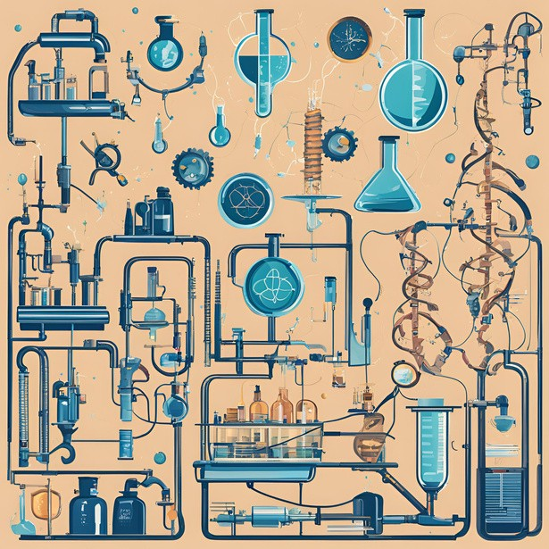
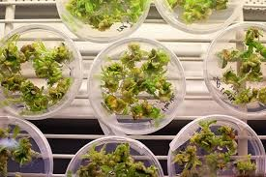
BIOTECHNOLGY
Biotechnology is the use of living things, like cells or microbes, to create products and solve problems.
1
2 3
BY USING CHEMICAL TO CREATE MEDICINES
MEDICINES CRATED USING PLANTS
BY USING FORMULA SCIENTIST

Slide 6
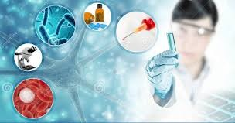
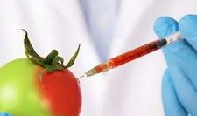

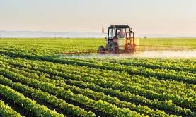
TABLETS
FOOD
INDUSTRY
AGRICULTURE

Slide 7
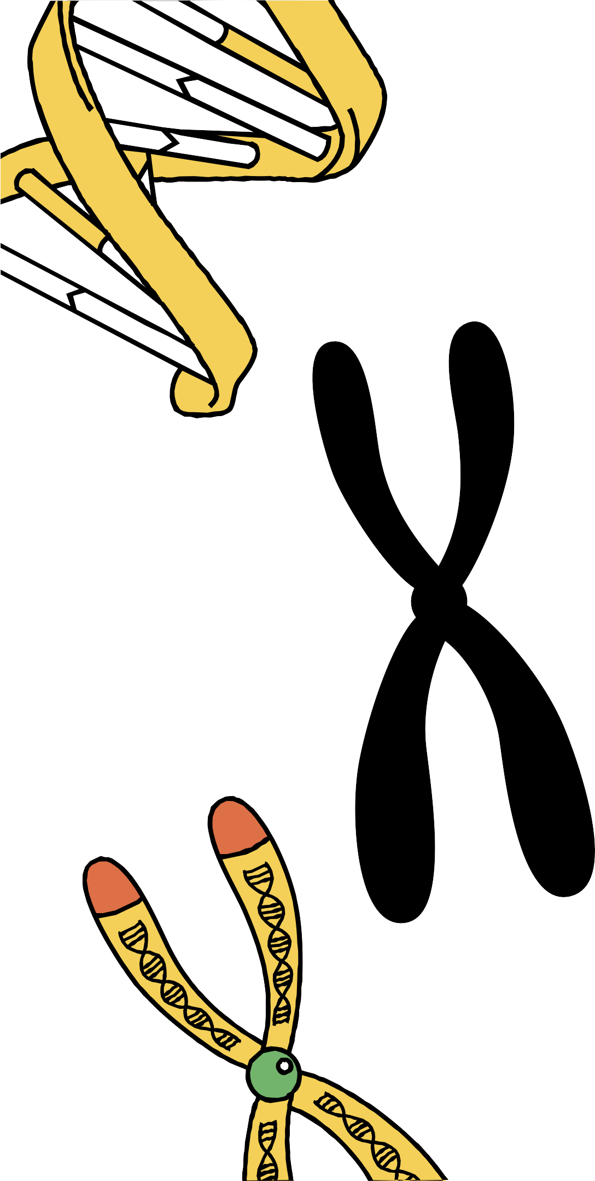
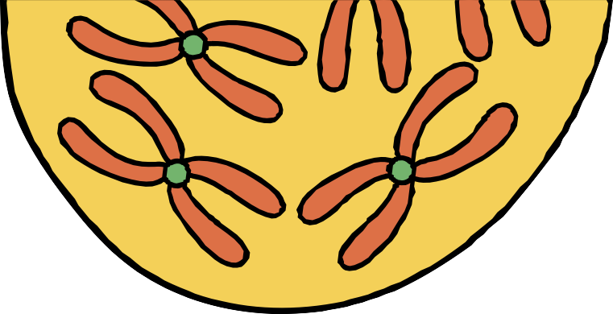
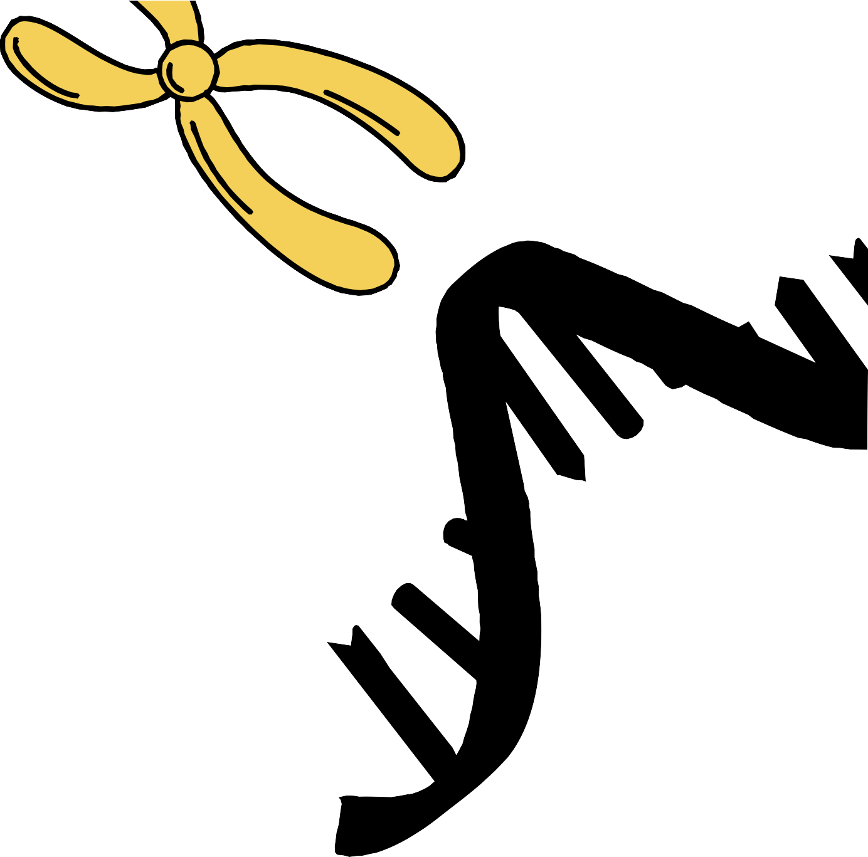
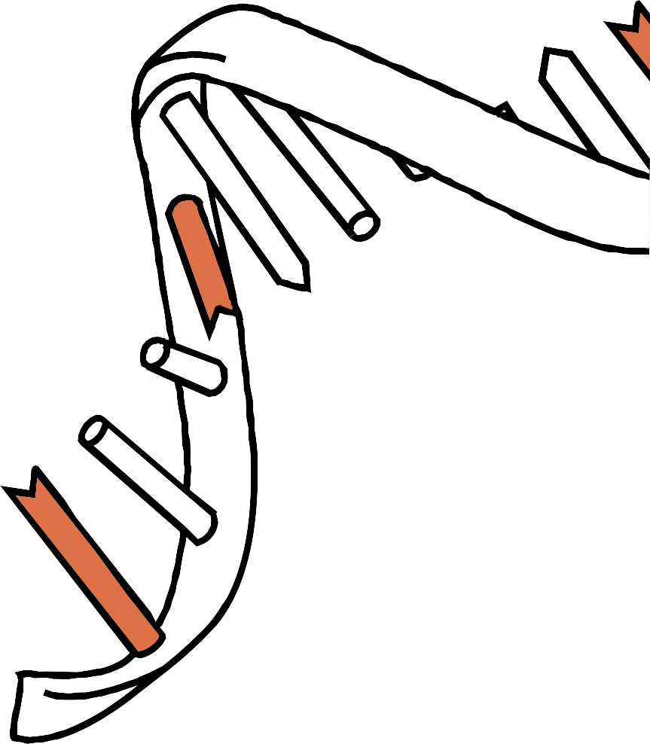
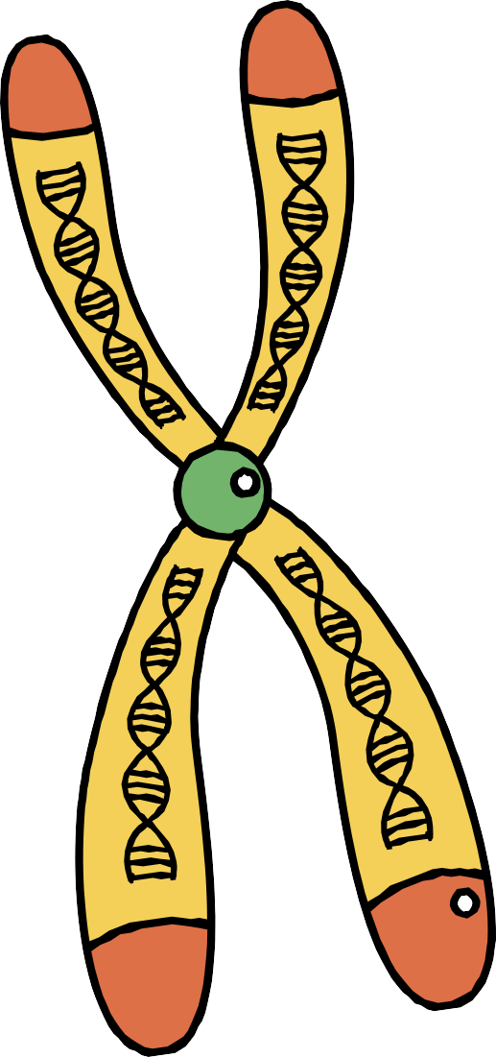


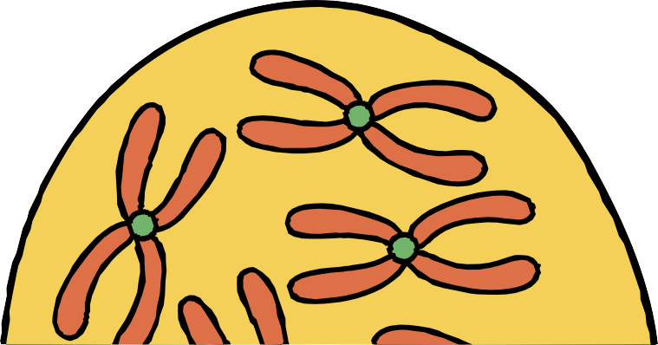
THANK YOU

